Slide 1
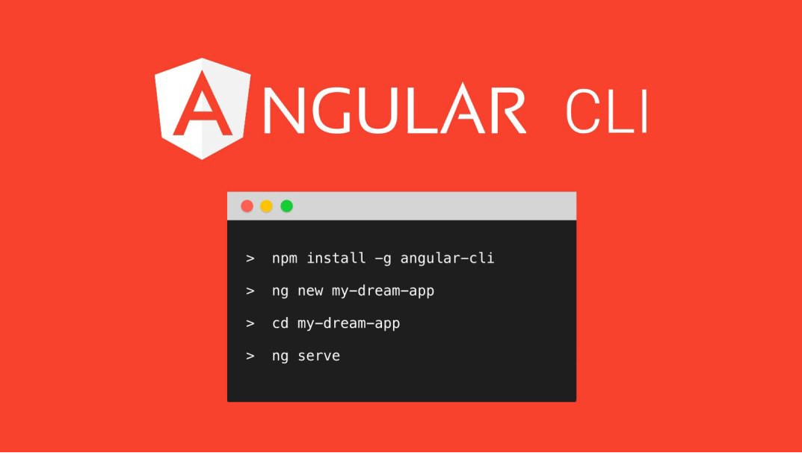

Slide 2
Angular CLI
With all of the new features Angular takes advantage of, like static typing, decorators and ES6 module resolution, comes the added cost of setup and maintenance. Spending a lot of time with different build setups and configuring all of the different tools used to serve a modern JavaScript application can really take a lot of time and drain productivity by not being able to actually work on the app itself.
Angular decided they would provide their own CLI to solve this problem. Angular CLI is geared to be the tool used to create and manage your Angular app. It provides the ability to:
create a project from scratch
scaffold components, directives, services, etc.
lint your code
serve the application
run your unit tests and end to end tests.

Slide 3
Angular CLI - Creating a New App
Use the ng new [app-name] command to create a new app.
This will generate a basic app in the folder of the app name provided.
The app has all of the features available to work with the CLI commands.
Creating an app may take a few minutes to complete since npm will need to install all of the dependencies.
The directory is automatically set up as a new git repository as well. If git is not your version control of choice, simply remove the .git folder and .gitignore file.

Slide 4
Angular CLI - Serving the App
The CLI provides the ability to serve the app with live reload.
To serve an application, simply run the command ng serve.
This will compile the app and copy all of the application-specific files to the dist folder before serving.
By default, ng serve serves the application locally on port 4200 ( http://localhost:4200 ) but this can be changed by using a command line argument: ng serve --port=8080

Slide 5
Angular CLI - Creating Components
The CLI can scaffold Angular components through the generate command.
To create a new component run:
ng generate component [component-name]
Executing the command creates a folder, [component-name], in the project's src/app path or the current path the command is executed in if it's a child folder of the project. The folder has the following:
[component-name].component.ts the component class file
[component-name].component.css for styling the component
[component-name].component.html component html
[component-name].component.spec.ts tests for the component

Slide 6
Angular CLI - Creating Other Things
The CLI can scaffold other Angular entities such as services, pipes and directives using the generate command.
ng generate [entity] [entity-name]
This creates the entity at src/app/[entity-name].[entity].ts along with a spec file, or at the current path if the command is executed in a child folder of the project. The CLI provides blueprints for the following entities out of the box:
Item | Command
Component: | ng g component [name]
Directive: | ng g directive [name]
Pipe: | ng g pipe [name]
Service: | ng g service [name]
Class: | ng g class [name]
Route: | ng g route [name]

Slide 7
Angular CLI - Linting
To encourage coding best practices Angular CLI provides built-in linting. By default the app will look at the project's tslint.json for configuration. Linting can be executed by running the command ng lint.
For a reference of tslint rules have a look at: https://palantir.github.io/tslint/rules/.

Slide 8
Angular CLI - Adding Third Party Libraries
The CLI generates development automation code which has the ability to integrate third party libraries into the application. Packages are installed using npm and the development environment is setup to check the installed libraries mentioned in package.json and bundle these third party libraries within the application. For more information see
https://github.com/angular/angular-cli#3rd-party-library-installation

